Slide 1
Slip, Trip, and Fall Prevention

Slide 2
Slip, Trip, and Fall Facts
According to the National Safety Council:
Slips and falls are the leading cause of death in the workplace.
Slips and falls account for more than 20% of all disabling injuries.

Slide 3
Objectives
Understand what causes slips, trips, and falls in healthcare.
Discuss solutions to preventing slips, trips, and falls.

Slide 4
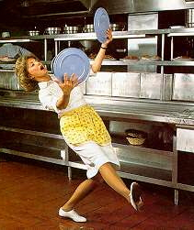
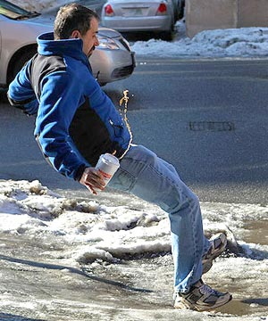
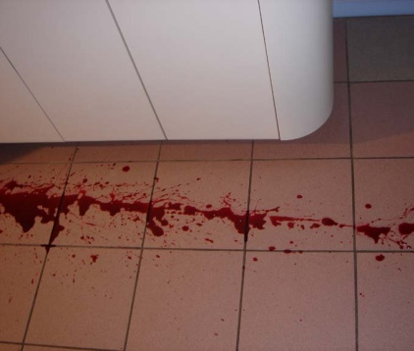
Slips
Slip: Loss of balance caused by too little friction between a person’s foot and a walking surface

Slide 5
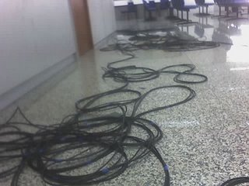
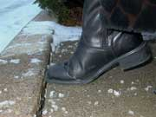
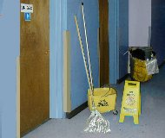
Trips
Trip: Hit an object, lose your balance, and fall.

Slide 6
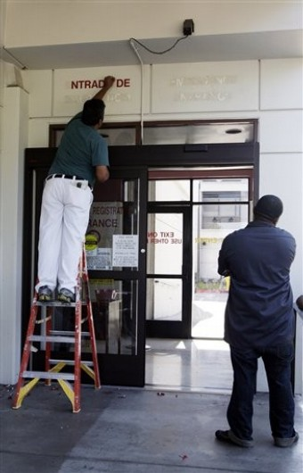
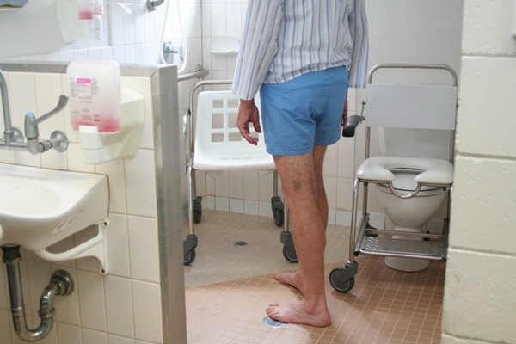
Falls
Fall: When you lose your balance and drop to the floor
Falls on the same level
Falls to lower level
Jumps to lower level

Slide 7
Causes of Slip, Trip, and Fall Accidents
Source: National Floor Safety Institute

Slide 8
What Can You Do to Prevent Slips, Trips, and Falls?
Always look for wet floors and spills on the floor.
Clean them up when you can.
When you can’t, make sure warning signs are used.
When it’s wet outside, make sure to wipe your shoes on entrance mats.

Slide 9
What Can You Do to Prevent Slips, Trips, and Falls?
Keep all cords out of the way or covered.
Keep all drawers closed.
Return patient equipment back to designated storage areas.
Wear appropriate footwear.
Watch your step!

Slide 10
Slip, Trip, and Fall Prevention

