Slide 1
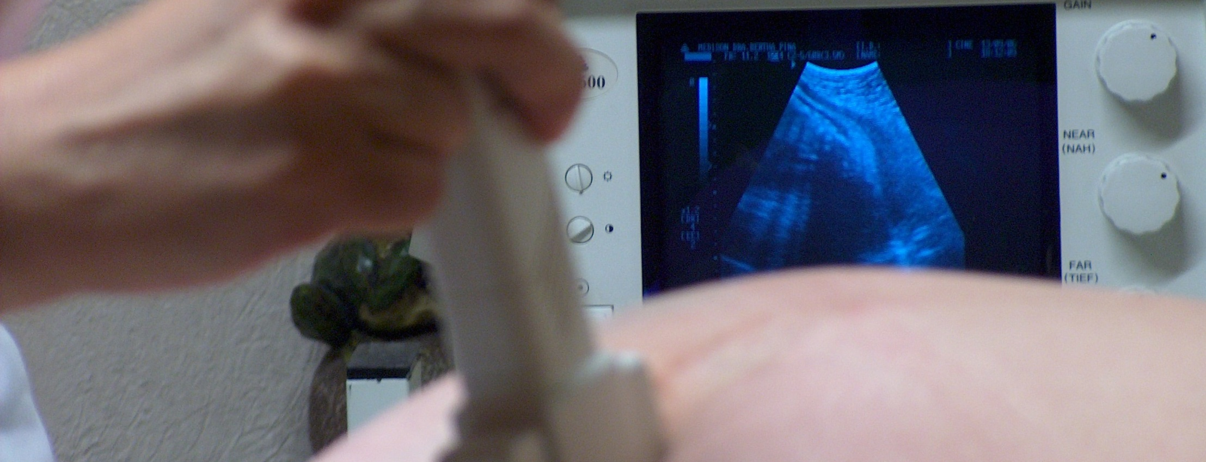
Sonography Safety

Slide 2
Objectives
Learn why sonography can be hazardous.
Recognize the symptoms of musculoskeletal disorders in sonographers.
Understand how to reduce your risks through prevention methods.

Slide 3
What Makes Sonography Hazardous?
Poor equipment placement
Awkward and static postures
Sustained pressure and force
Repetitive motions
Assisting with patient movement
Inadequate work breaks

Slide 4
What Makes Sonography Hazardous?
Increased time spent by sonographers performing sonography only
Increased number of ultrasound examinations being performed
Fewer changes in activities during procedures

Slide 5
Symptoms of Musculoskeletal Disorders in Sonographers
Pain in the neck, shoulder, or arm
Numbness in the hand, wrist, or elbow
Tingling, itching, or burning sensations in the hand or arm
Swelling in the wrist or hand
Weakness in the arms

Slide 6
What Can You Do?
Stretch before you start your scheduled work and throughout the day.
Adjust equipment to the patients size and to your surroundings.
Ensure that the patient is in close proximity to you.

Slide 7
What Can You Do?
Use a cushion or rolled-up towel to support your arm and wrist.
Minimize or avoid awkward and static postures.
Alternate between sitting and standing.

Slide 8
What Can You Do?
Ensure that your arm abduction is less than 30 degrees while scanning.
If ambidextrous, alternate hands.
If gloves are needed, use textured gloves.

Slide 9
What Can You Do?
If bedside, rearrange furniture or equipment to improve posture.
Take micro-breaks.
Take mini-breaks.

Slide 10

What Can You Do?
Vary work tasks whenever possible.
Attend training when offered.

Slide 11
Sonography Safety

