Slide 1
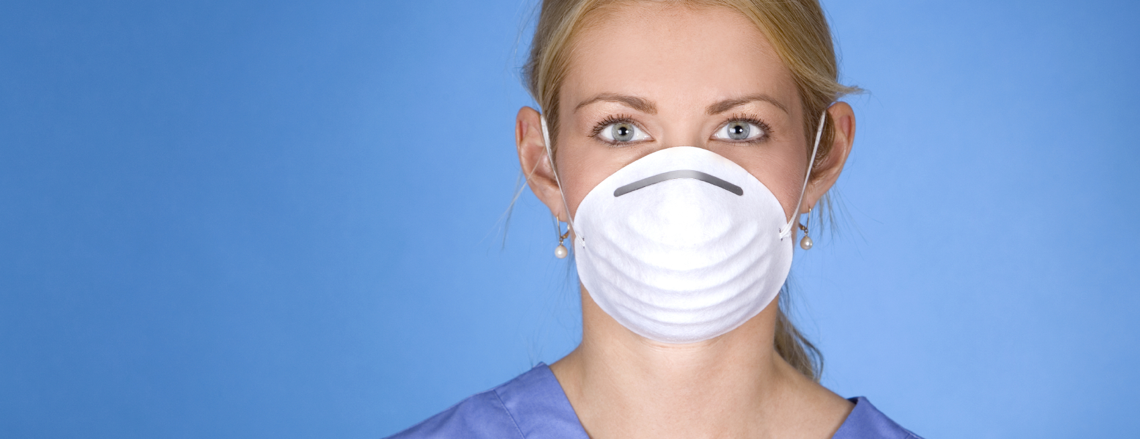
Respirator Safety

Slide 2
Objectives
Learn why a medical evaluation is necessary before using a respirator.
Understand why fit testing is important.
Know why following proper procedures is essential.
Review items you should be trained on.

Slide 3
Why is Medical Evaluation Necessary?
To determine your ability to use a respirator safely
  Physical ability
    Strength
    Medical conditions
      Lung
      Heart
      Vision
      Hearing
      Anxiety

Slide 4
Why is Fit Testing Important?
To determine:
  The most acceptable respirator for you
  How to put on the respirator
  Comfort level and adequacy of fit
    Position on nose
    Room for eye protection
    Room to talk
    Position of mask on face and cheeks

Slide 5
Why is Fit Testing Important?
To show you how to conduct a seal check
To perform test exercises
  Qualitative fit test
    Subjective sensation (taste, smell)
  Quantitative fit test
    Instrument measures airborne particles inside the mask (seal leakage)

Slide 6
Fit Testing
Performed:
  Prior to use
  Annually
  When facepiece is changed
  When your physical condition changes

Slide 7
What Are The Procedures to Follow?
Obtain a medical evaluation.
Undergo fit testing.
Select appropriate respirator.
Use only your assigned respirator.
Perform a seal check each time you use a respirator.
Wear a respirator in any situation that could expose you to hazardous airborne agents.

Slide 8
What Should You Receive Training On?
When a respirator is necessary
How to put on and remove a respirator properly
Capabilities and limitations of respirators
How to inspect a respirator
How to check the seal
How to maintain and store the respirator
Recognition of medical signs and symptoms that may prevent or limit use

Slide 9
Respirator Safety

