Slide 1
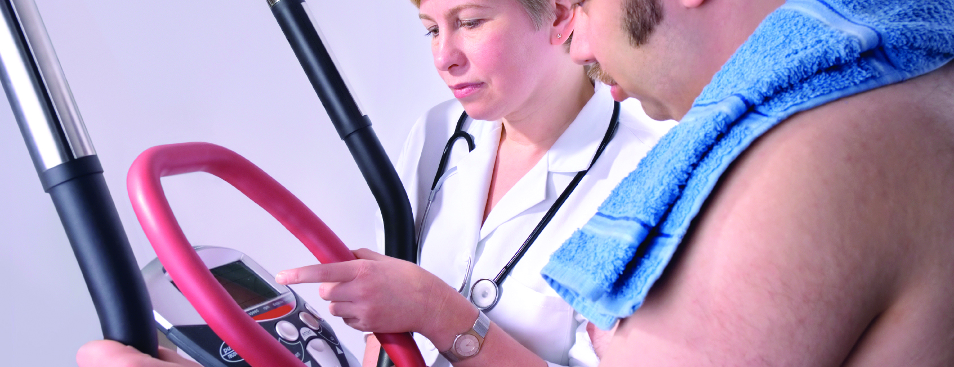
Obesity in
Healthcare’s Workforce

Slide 2
Objectives
Recognize risks associated with obesity.
Understand how to reduce those risks.
Learn prevention strategies.

Slide 3
Did You Know?
In the U.S., 74 million individuals are overweight.
66 million are obese.
69% of U.S. adults are overweight.
36% of U.S. adults are obese.

Slide 4
What Can You Do?
Utilize equipment to make lifting and other strenuous tasks easier and safer.
  Patient care
  Housekeeping
  Laundry
  Maintenance
  Food service

Slide 5
What Can You Do?
Participate in employee wellness program.
  Get a physical each year.
  Reduce your weight.
  Exercise regularly.

Slide 6
What Can You Do?
Participate in employee wellness program.
  Eat healthy.
  Manage chronic diseases.
  Use Employee Assistance Program.

Slide 7
What Can You Do?
Follow procedures for working safely.
Attend safety training offered.

Slide 8
Obesity in
Healthcare’s Workforce

