Slide 1
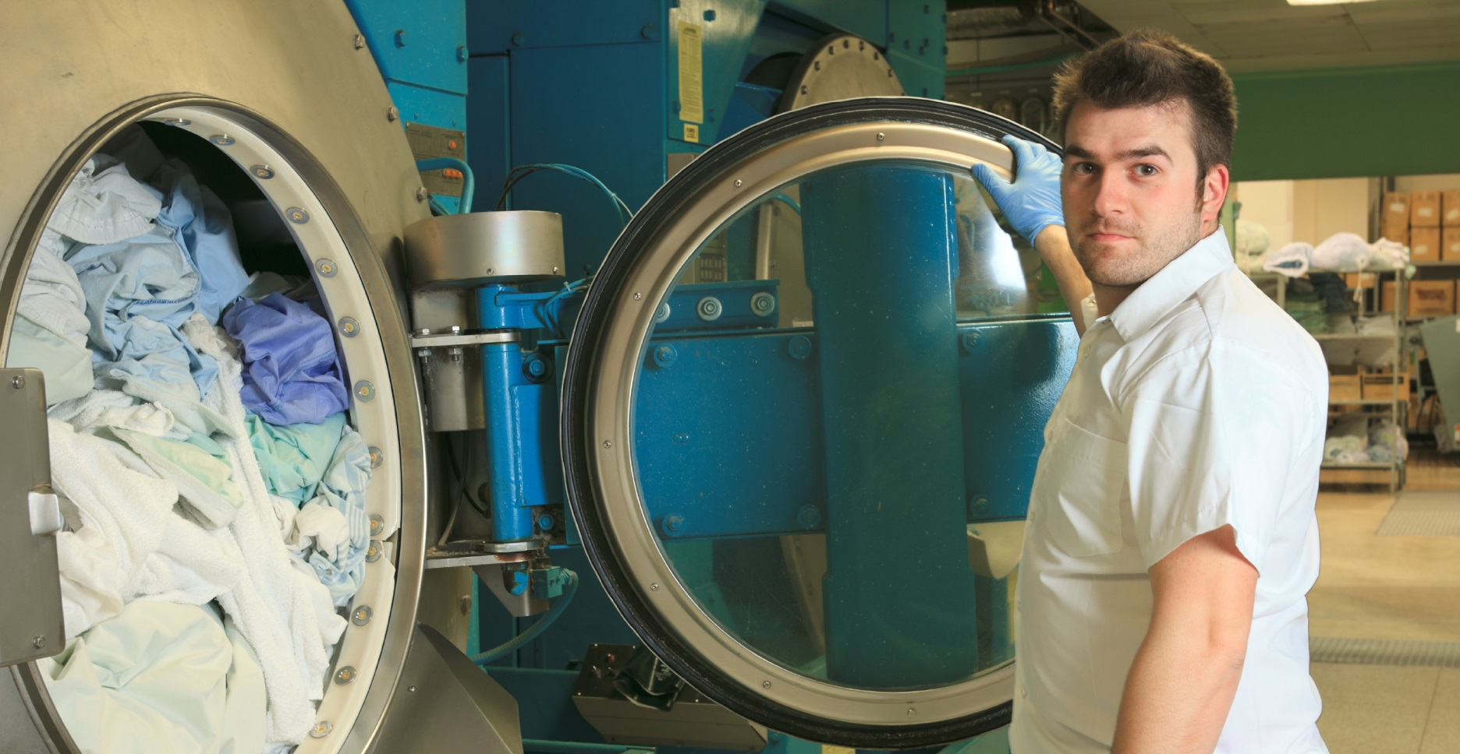
Laundry Safety - Lifting
Use mechanical lifts.
Use proper lifting techniques.
Avoid awkward and twisting postures.
Limit the amount to be lifted.

