Slide 1
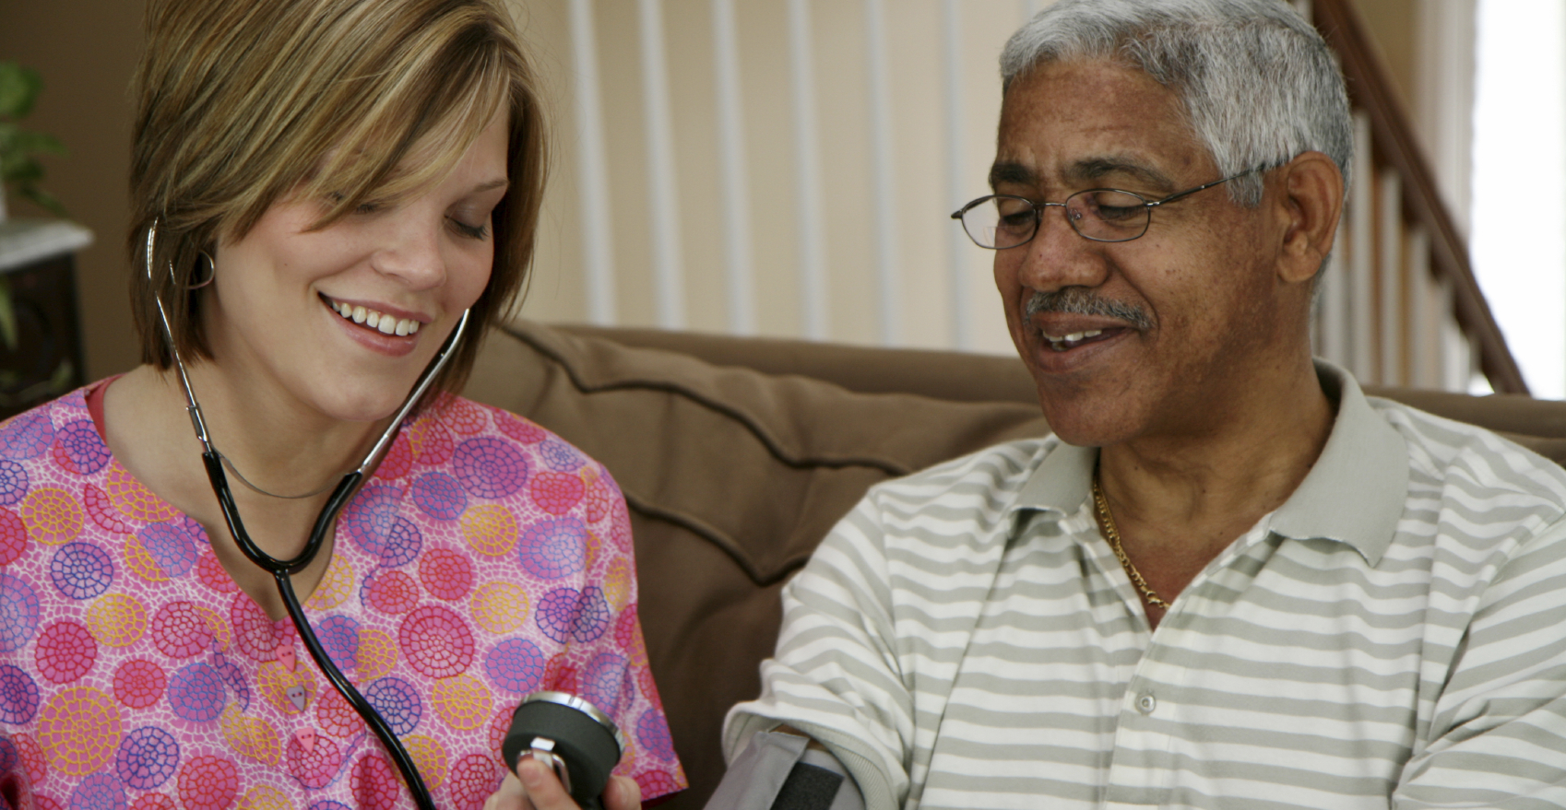
Home Care Safety
Practice defensive driving skills.
Determine the best/safest procedure for handling a patient.
Wear slip-resistant shoes.
Ensure that pets are secured before
entering a patient’s property.

