Slide 1
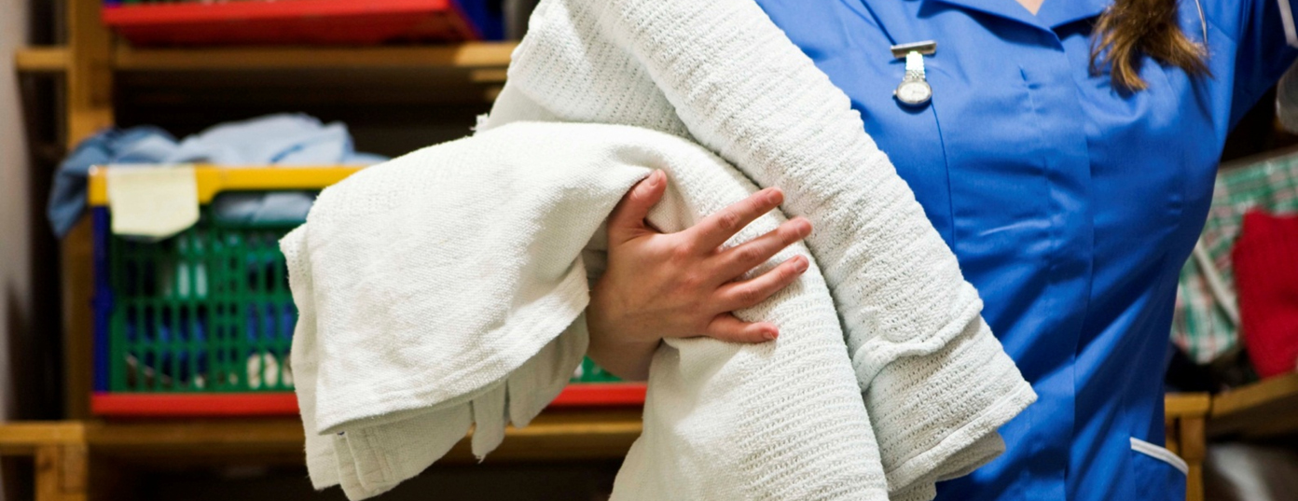
Laundry and Housekeeping Safety

Slide 2
Objectives
Identify hazards in laundry and housekeeping.
Learn ways to protect yourself from these hazards.

Slide 3
Environmental Services
Hazard
Handling contaminated laundry
  Exposure to blood or other potentially infectious materials
Protection
  Wear appropriate personal protective equipment (PPE).
  Bag and handle contaminated laundry at location where it is used.
  When sorting or rinsing contaminated laundry, transport it in properly labeled/color-coded bags or containers to the laundry area for decontamination.
  Do not hold contaminated laundry bags close to the body or squeeze them.

Slide 4
Environmental Services
Hazard
Needles/sharps
  Exposure to bloodborne pathogens from laundry that contains needles/sharps
Protection
  Visually check all laundry for needles/sharps BEFORE handling.
  Wear appropriate PPE.
  Properly dispose of any discovered needles/sharps into designated sharps containers.

Slide 5
Environmental Services
Hazard
Hazardous Chemicals
  Exposure from cleaning chemicals found in laundry or housekeeping products, including unlabeled chemicals, splattering when pouring chemicals, soaps detergents, and mixing chemicals
Protection
  Know where your Safety Data Sheets (SDS) are located.
  Understand warning labels and SDS.
  Wear PPE like gloves, goggles, and splash aprons when handling hazardous detergents and chemicals.

Slide 6
Environmental Services
Hazard
Heat Stress
  Exposure to excessive heat from working in hot areas
Protection
  Recognize the first signs of heat exhaustion and heat stroke.
  Drink plenty of water.
  Avoid caffeine.
  Wear loose-fitting, breathable (cotton) clothing.
  Take appropriate rest breaks as allowed by your facility.

Slide 7
Environmental Services
Hazard
Lifting/pushing/pulling
  Exposure when lifting, reaching, pushing, or pulling heavy objects like wet laundry, trash containers/bags, and cleaning carts
Protection
  Avoid using improper lifting techniques such as twisting, lifting bulky objects, and lifting above shoulder height.
  Use well-maintained carts, preferably with large wheels, when available.
  Use mechanical aids as directed by your supervisor/policy.

Slide 8
Environmental Services
Hazard
Slips/trips/falls
  Exposure from wet floors, cords, other objects, and various floor surfaces
Protection
  Clean up non-hazardous/non-infectious spills when you first find them (use PPE as required).
  Use warning signs for wet floors.
  Use mats in wet areas.
  Look for cords and other trip hazards.

Slide 9
Laundry and Housekeeping Safety

